Slide 1
Education In Trentino
Project of: Knowledge and Data Integration
Professor: Giunchiglia Fausto
A.y.: 2021/2022
by:
Ali Hamza
Tecla Venturelli

Slide 2
Index
Purpose and Resources
Inception phase
Informal modeling phase
Formal modeling phase
Data integration phase
Conclusion

Slide 3
Purpose and Resources

Slide 4
Starting purpose: A service which help the students to find university courses, projects and material to support their education and university career.
Resources: The initial resources collect included a range of information that was too large, so we decided to restrict the scope.

Slide 5
Inception phase

Slide 6
Purpose formalization
A service that will help parents and students to find schools, including details about the school and courses offered, in the region of Trentino based on city, comune, school type, course duration and teaching activities schedules.
Domain of interest: compulsory education in Trentino in the current time.
Personas and scenarios: (italian and not italian) under-age students and their parents; people involved in monitoring education activities (municipal workers); adults in need of a certification.
CQs formalization: from the scenarios we formulated some CQs (How many science schools are in Trento? Are there any art school in my via/block where teaching activities are carried out in the evening?).

Slide 7
Entity types classification in reusability categories
The consepts extracted from the CQs are organized in the reusability categories: common, core, contextual.
Common: Educational institution, Location, Person.
Core: School, Student.
Contextual: Pubblic school, Private school, Primary school, Middle school, High school, Study course.

Slide 8
Collection of Data and Knowledge resources + DTA1
Discarding unappropriate datasets.
Finding the most appropriate knowledge resources that already contain a description of the etypes we need to model.
Aligning the datasets different formats.
Datasets: 4 datasets, 2 retrived from the portal OPENdata TRENTINO (XML) and 1 from Wikipedia (excel → CSV). Dataset of Course Offered by University of Tretno (CSV)
Knowledge: we decided to use Schema.org, a general purpose knowledge source.

Slide 9
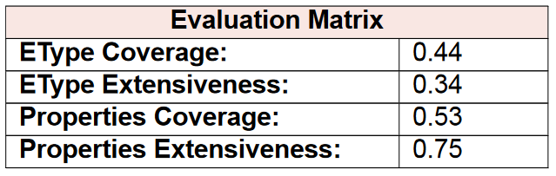
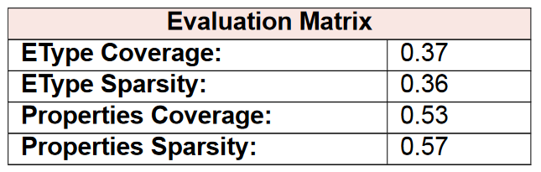
Evaluation
Schema level evaluation: CQs vs knowledge resources
Data level evaluation: CQs vs datasets

Slide 10
Informal modeling phase

Slide 11
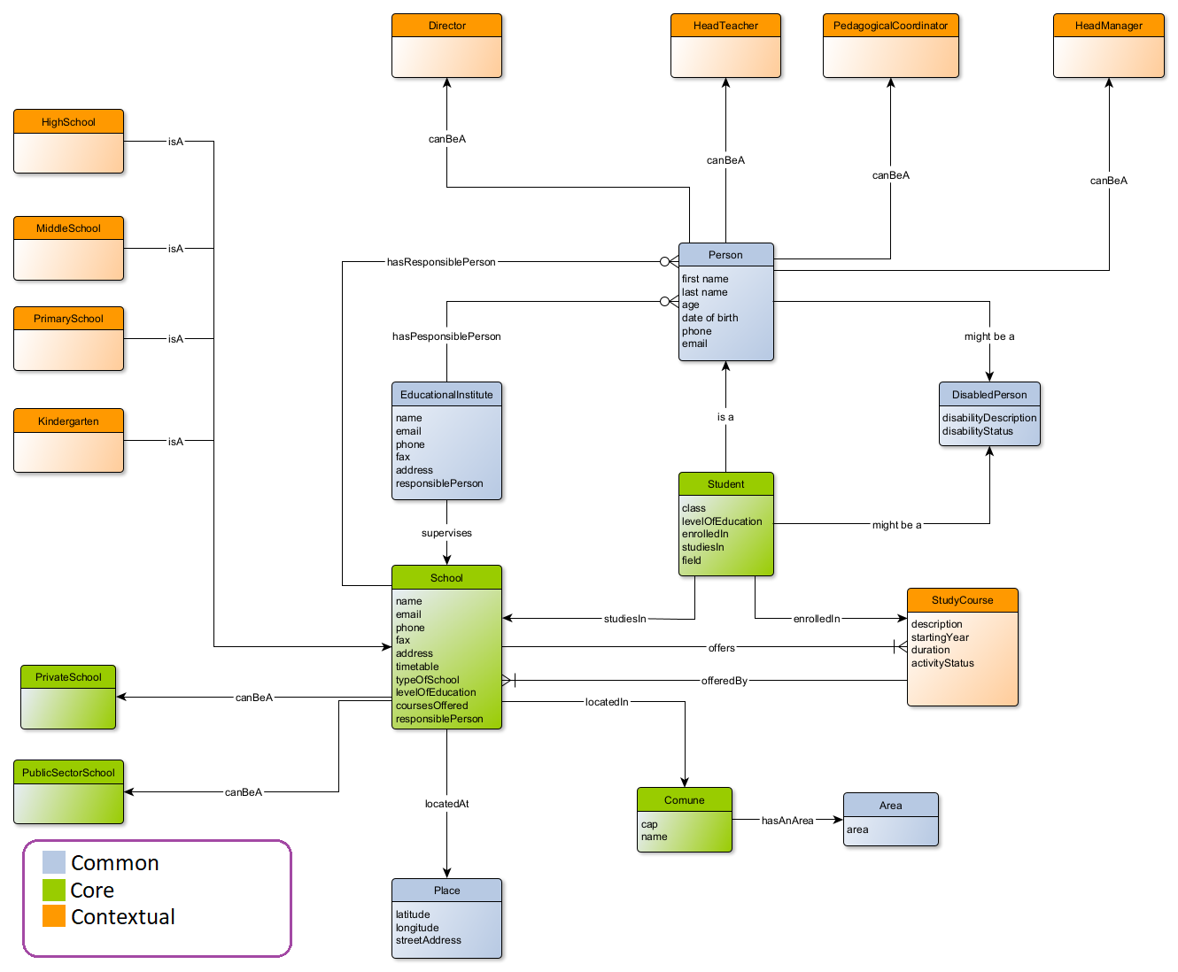
CQs finalization and teleology foundation
The common, core and contextual concepts were further categorized in: object, function, action.
Data properties and object properties were also assigned.
The schema resulting exclusively from the CQs was the following
The hierarchical relations were thought to be consistent with the relations found in Schema.org.

Slide 12
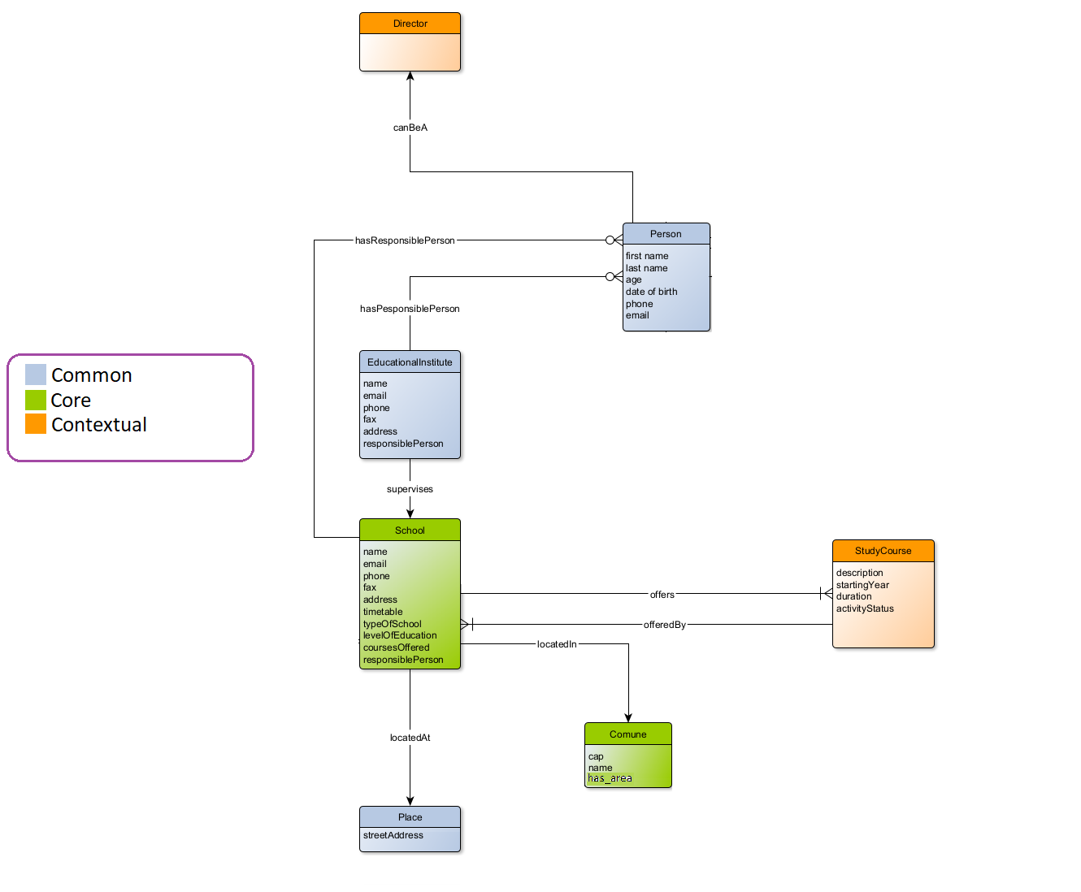
ER model generation
Modeling the Etypes and attributes extracted from the CQs and that are present in the datasets selected.

Slide 13
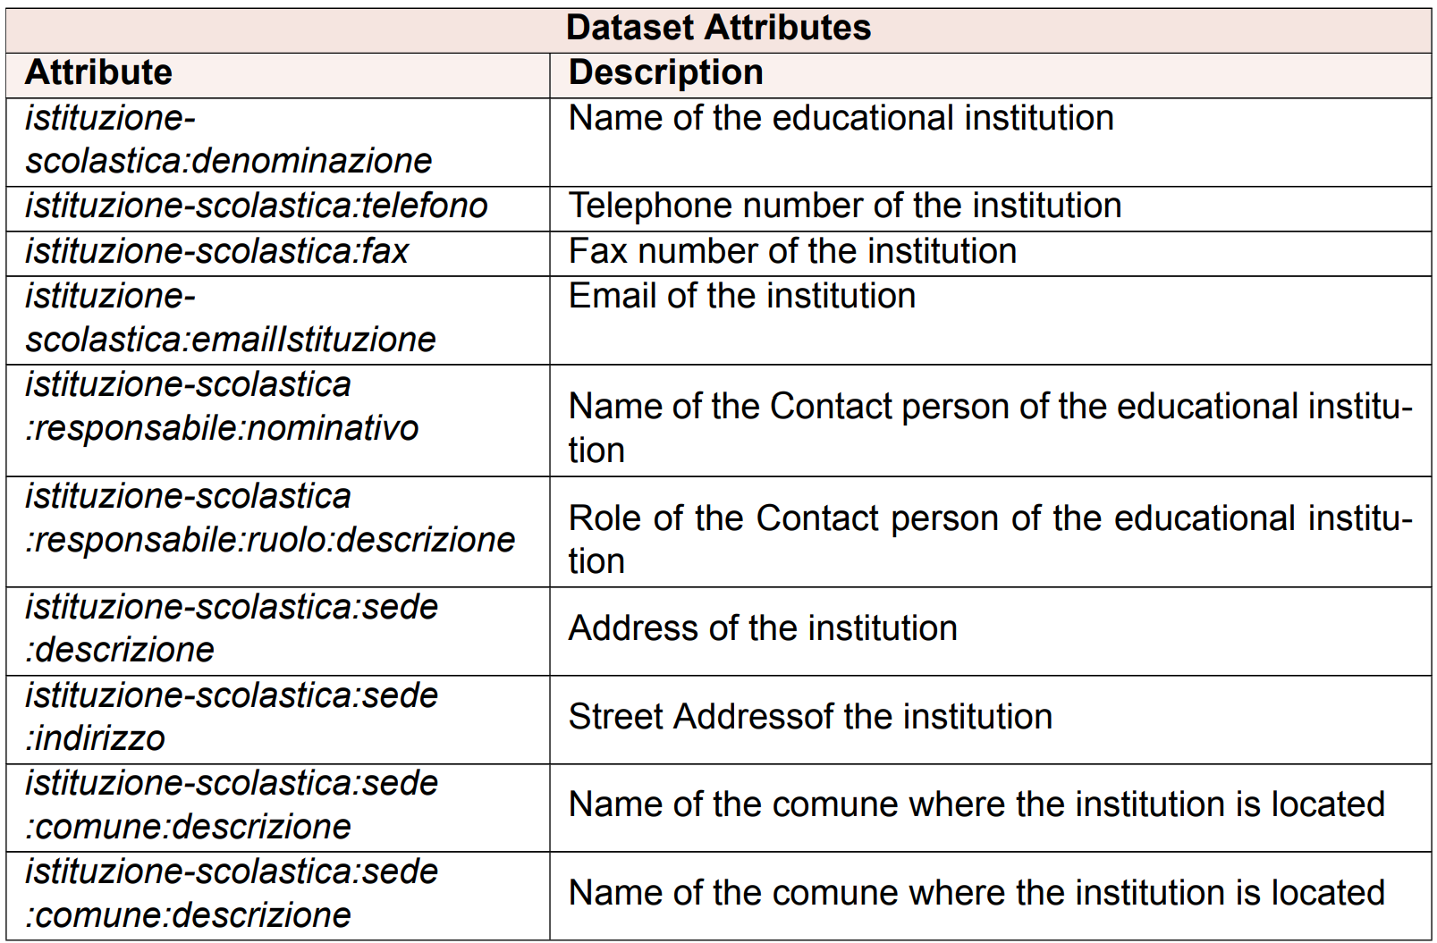
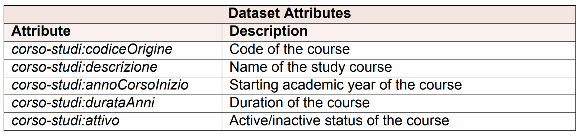
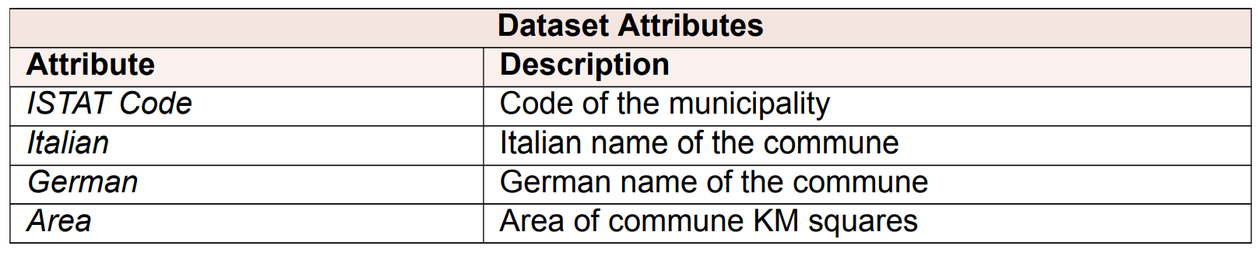
Datasets Management
Removal of Useless Datasets (Unitn courses dataset)
Dataset Cleaning – Removal of garbage/useless values

Slide 14
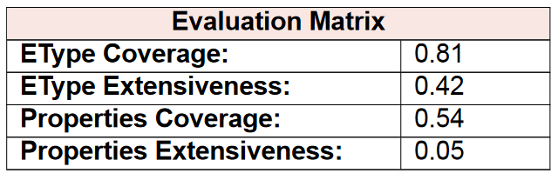
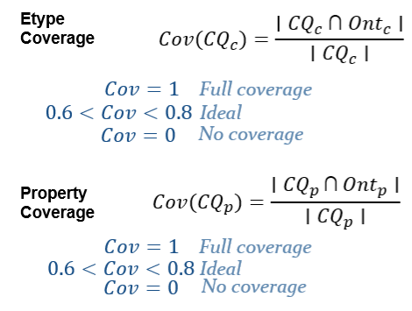
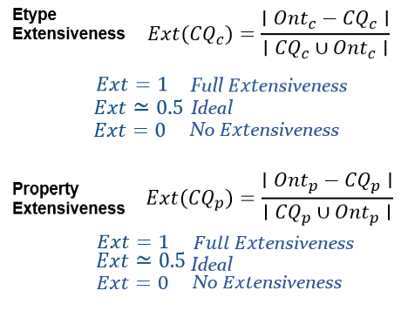
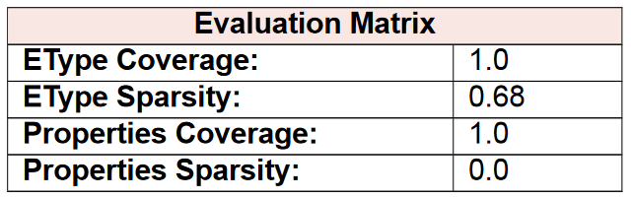
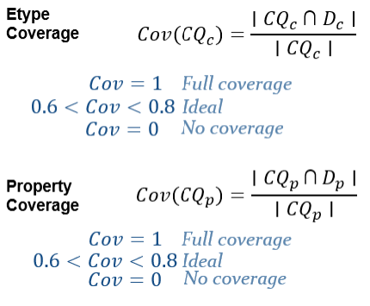
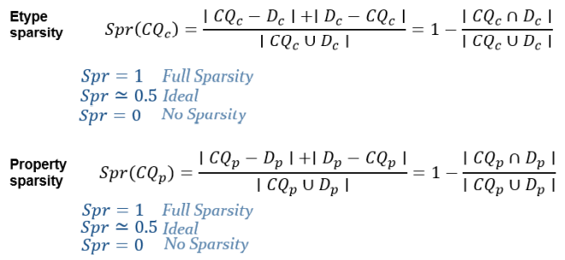
Evaluation
Schema level evaluation: CQs vs ER model
Data level evaluation: ER model vs datasets

Slide 15
Formal modeling phase

Slide 16
Making the ETG shareable using ontology.
- Ontology selection
- Language alignment
- Schema building
Addressing syntactic heterogeneity.
- Data types misalignment
- Data value format misalignment
- Data value language misalignment

Slide 17
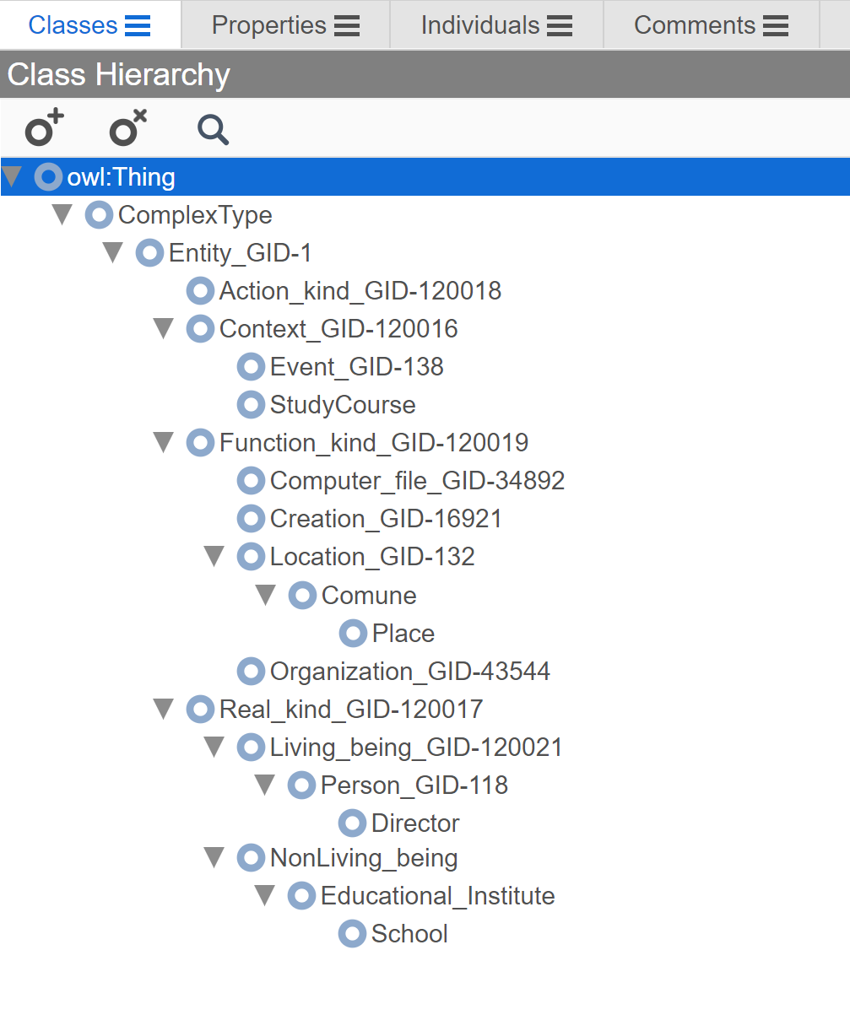
Ontology selection
Starting from a base model with hierarchical structure, that takes into consideration the classification of the concepts performed in the previous phases, we designed the ETG with protègè tool, considering the only entities present in our datasets usefull for our purpose.
Object and Data properties were also created (respectively outgoing and ingoing edges).
This step also ensures the schema alignment since the model schema is based on a hierarchical structure.

Slide 18
Language alignment
KOS tool starting from the ETG .owl file produced by protègè
All the entities and functional attributes where mapped
Reusing elements already present
New GIDs generated for some attributes: e.g. levelOfEducation, courseOffered
New shareable ETG (.owl)

Slide 19
Addressing syntactic heterogeneity
The great part of the attributes are not repeated among datasets. Since the data source was reliable, and 2 of the 3 datasets came from this resource we did not have problems (ex. course-code and codiceOrigine respectively in ds1 and ds2 reffer to the same thing, and they have the same values).
- Data types misalignment
- Data value format misalignment
- Data value language misalignment

Slide 20
Data integration phase

Slide 21
Addressing semantic heterogeneity
Requirements:
Datasets: ds1 was split in 3 datasets (Schools in Trentino, Institutions, Resposible Person of Institution)
Ontology: shareable ETG model
Populating the ETG with the datasets entities aligned using KarmaLinker
- Entity alignment: entity corrispondance between datasets and ETG. 1 to 1 mapping of the attributes present in the ETG, some attributes in the datasets were unmapped.
- Entity matching: entity corrispondance among a datasets, in this way the datasets are joint and mapped.

Slide 22
Datasets Complex Structure Challanges
Complex dataset structure was hard to map.
Data set of education institutes + schools
Next structure of the dataset
XML format
Division of Datasets into Smaller Datasets
Dataset was devided into 3 smaller datasets
Easy to Map in Karmalinker
Uniform CSV format of all datasets
-Data integration phase-

Slide 23
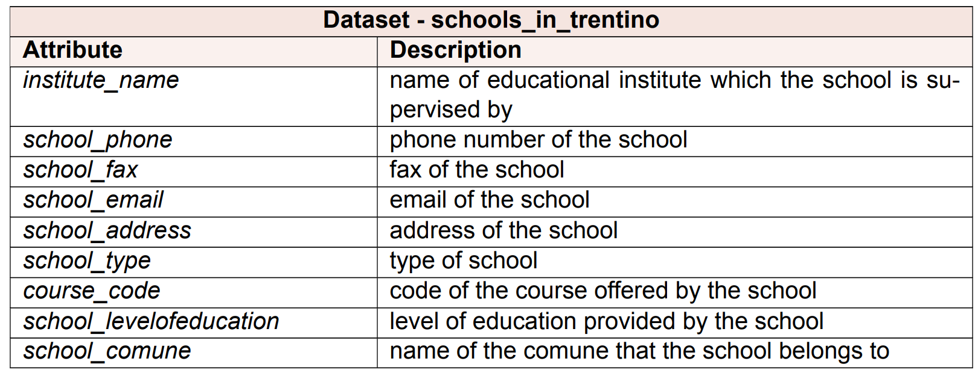
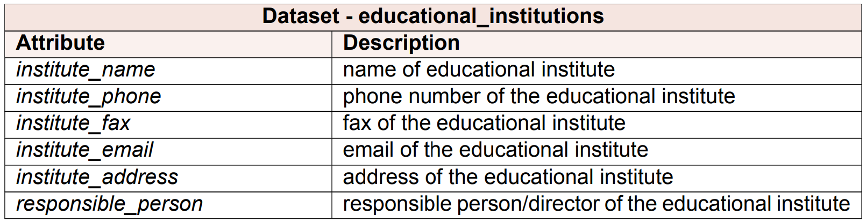
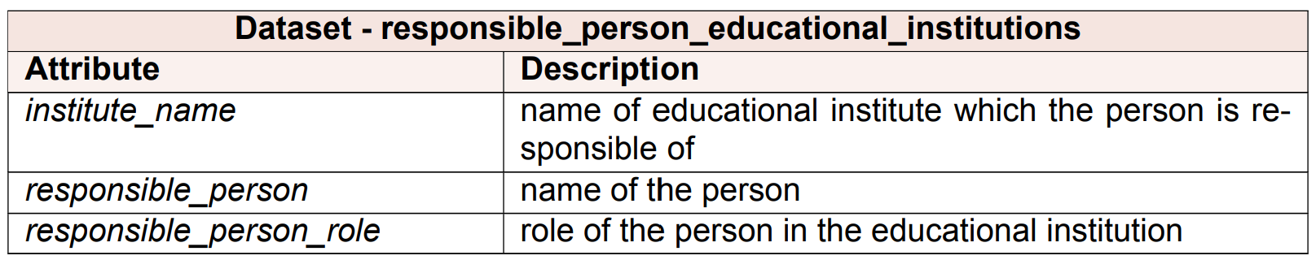
New Splitted Datasets

Slide 24
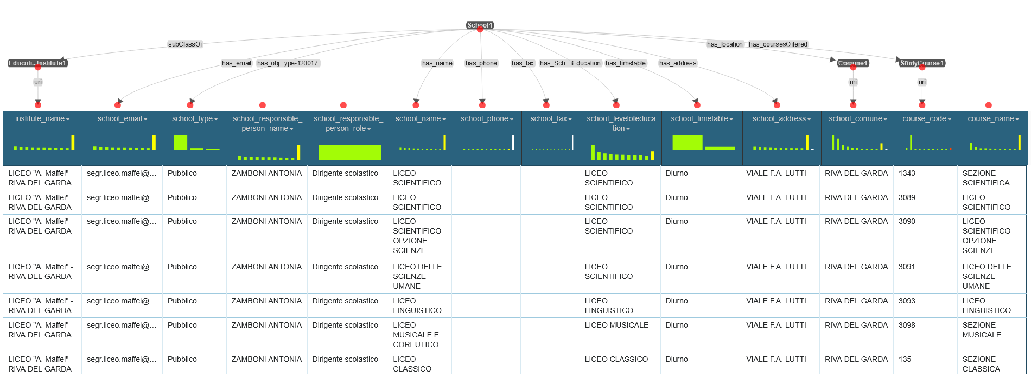
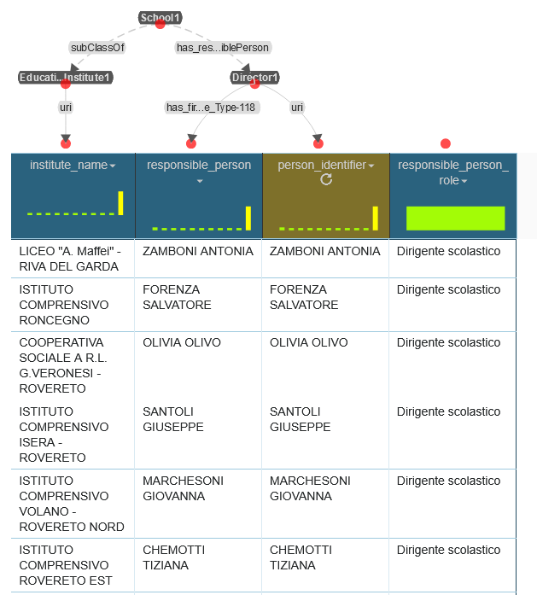
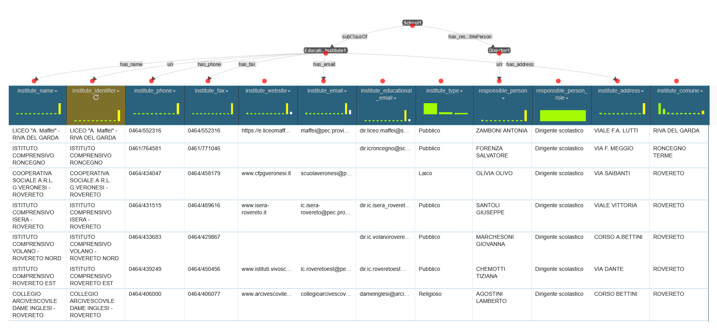
Datasets mapping in KarmaLinker

Slide 25
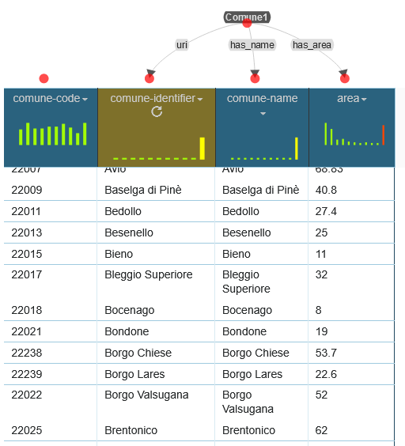
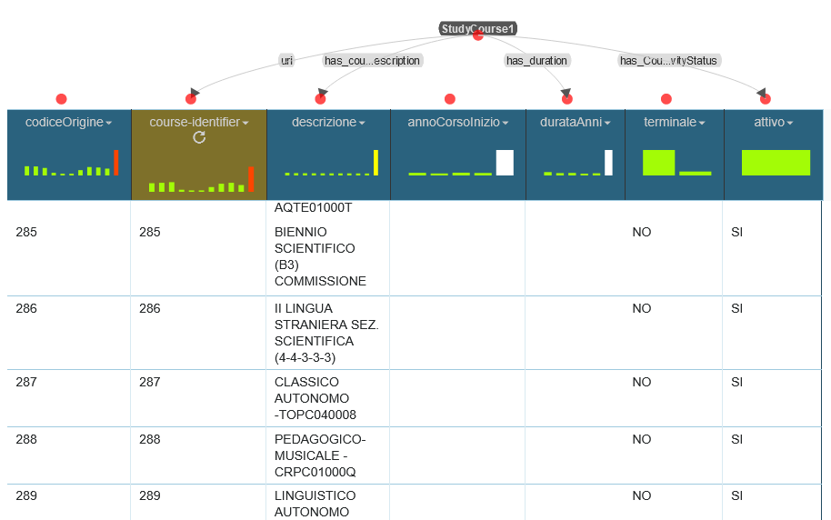
Datasets mapping in KarmaLinker

Slide 26
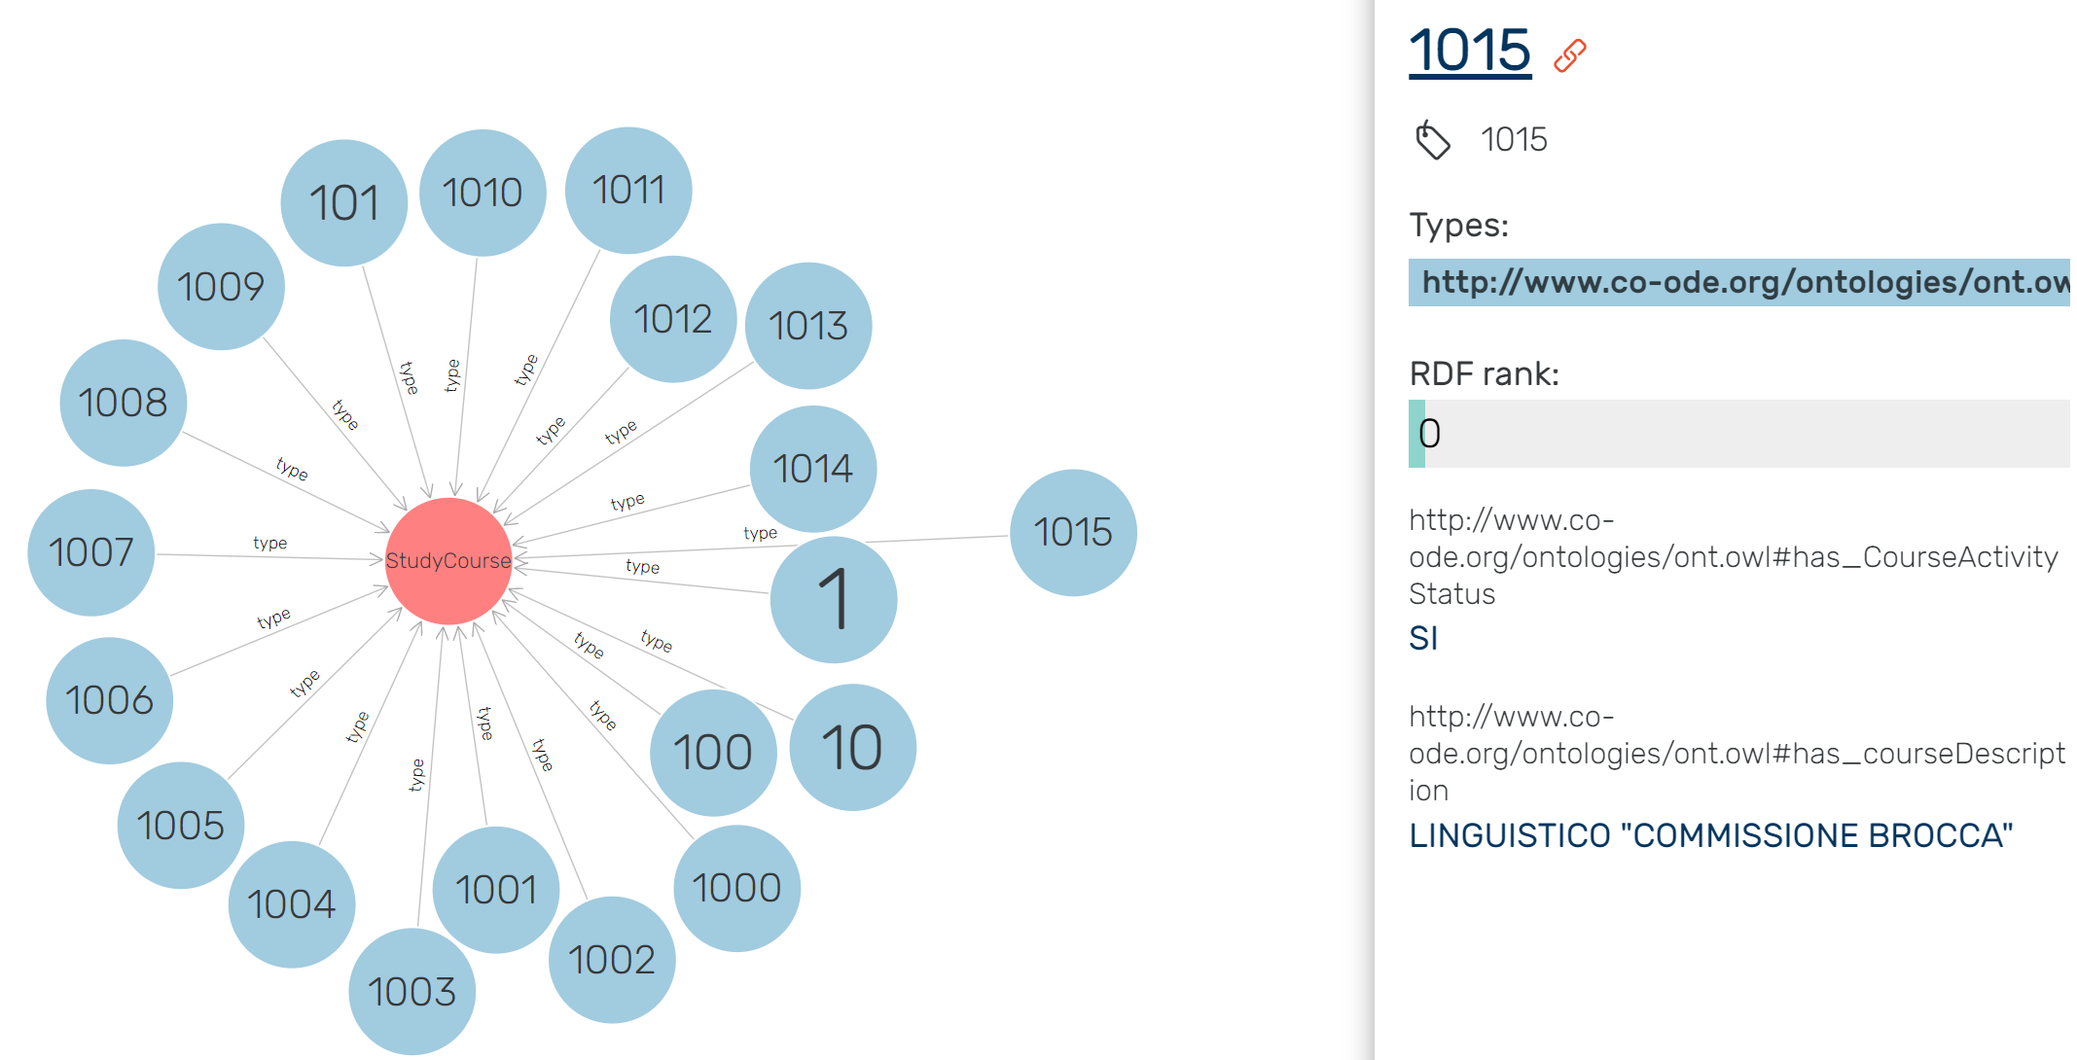
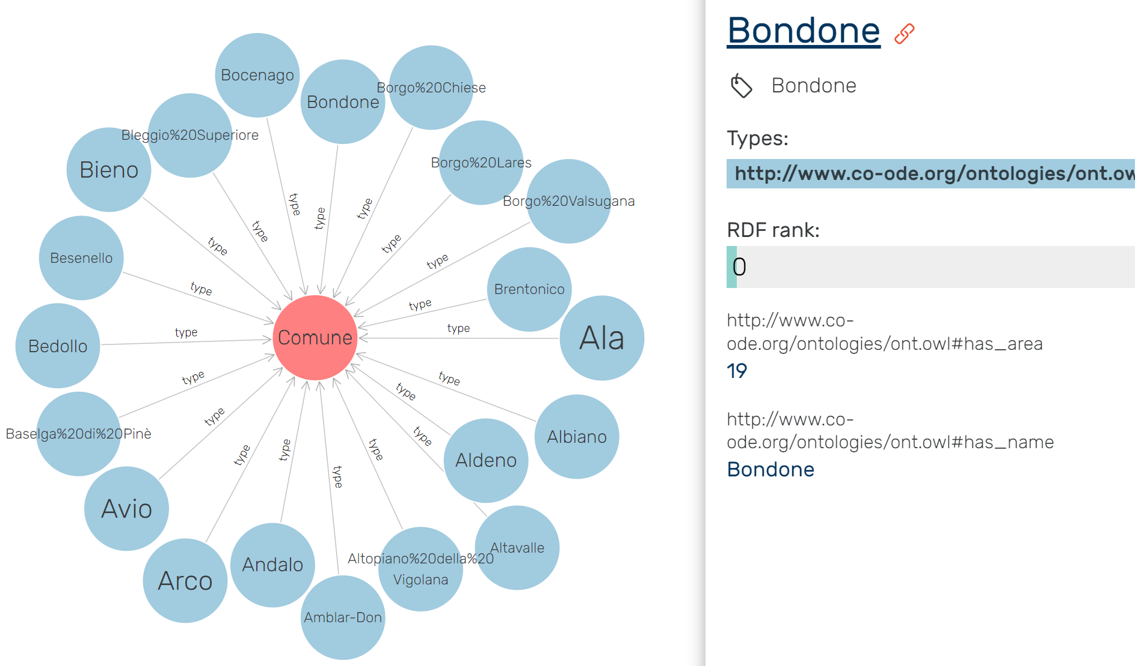
KG visualization
graphDB
Just 2 out of 5 available
Error occured

Slide 27
Evaluation
No possibility to use SQL
But we can do qualitative evaluations:
Most of the attributes in the datasets are used;
No cycles in class hierarchy
Polysemous term are not present (no repeated attributes name)
No semantically identical classes
All the classes have a domain and a range

Slide 28
Conclusion

Slide 29
That project takes into consideration the education in Trentino. Since it respects the principles of reusability and shareability of the iTelos methodology it would be possible to extend it. In space, but also adding more information (some of the CQs formulated can not be answered).
Some attributes in datasets are not mapped (institution web page, that would be important).
We are not able to properly explore the final KG.

